Slide 1
Banco di Portugal’s 2014 Long-Term Deposit Telemarketing Campaign
Data Exploration & Analysis

Slide 2
Aims of this Presentation
This presentation intends to showcase various analyses I have made from a dataset originally put together to predict the success of telemarketing campaigns selling long-term bank deposit accounts
My analyses and this presentation do not attempt to reproduce the results of the original project but instead aim to explore the data and, where possible, derive some preliminary insights on how future campaigns could be tweaked in order to boost their success
Those behind the original research, the details of which are cited on the following slide, employed machine learning techniques in a way beyond my current capabilities to predict the success of telemarketing calls, but I have produced some meaningful results of my own by using a K-Nearest Neighbors model on four socio-economic features of each data point

Slide 3
Details of Original Research Project
This presentation references a dataset containing various attributes of a selection of Banco di Portugal’s clients and the outcomes of a telemarketing campaign they ran to sell long-term deposit accounts
The official abstract for the associated research project is quoted on the next slide
Data available here: http://archive.ics.uci.edu/ml/datasets/Bank+Marketing)
Originally described and analysed by Sérgio Moro (ISCTE-IUL), Paulo Cortez (Univ. Minho) and Paulo Rita (ISCTE-IUL)
Citation: [Moro et al., 2014] S. Moro, P. Cortez and P. Rita. A Data-Driven Approach to Predict the Success of Bank Telemarketing. Decision Support Systems, In press, http://dx.doi.org/10.1016/j.dss.2014.03.001. Available at:
[pdf] http://dx.doi.org/10.1016/j.dss.2014.03.001
[bib] http://www3.dsi.uminho.pt/pcortez/bib/2014-dss.txt
Dataset contains 41188 rows and 21 columns

Slide 4
(Abstract of Original Research Project)
“We propose a data mining (DM) approach to predict the success of telemarketing calls for selling bank long-term deposits. A Portuguese retail bank was addressed, with data collected from 2008 to 2013, thus including the effects of the recent financial crisis. We analyzed a large set of 150 features related with bank client, product and social-economic attributes. A semi-automatic feature selection was explored in the modeling phase, performed with the data prior to July 2012 and that allowed to select a reduced set of 22 features. We also compared four DM models: logistic regression, decision trees (DTs), neural network (NN) and support vector machine. Using two metrics, area of the receiver operating characteristic curve (AUC) and area of the LIFT cumulative curve (ALIFT), the four models were tested on an evaluation set, using the most recent data (after July 2012) and a rolling window scheme. The NN presented the best results (AUC = 0.8 and ALIFT = 0.7), allowing to reach 79% of the subscribers by selecting the half better classified clients. Also, two knowledge extraction methods, a sensitivity analysis and a DT, were applied to the NN model and revealed several key attributes (e.g., Euribor rate, direction of the call and bank agent experience). Such knowledge extraction confirmed the obtained model as credible and valuable for telemarketing campaign managers.”

Slide 5
Dataset Column Names & Descriptions
# bank client data:
1 - age (numeric)
2 - job : type of job (categorical: "admin.","blue-collar","entrepreneur","housemaid","management","retired","self- employed","services","student","technician","unemployed","unknown")
3 - marital : marital status (categorical: "divorced","married","single","unknown"; note: "divorced" means divorced or widowed)
4 - education: (categorical: "basic.4y","basic.6y","basic.9y","high.school","illiterate","professional.course","university.degree","unknown")
5 - default: has credit in default? (categorical: "no","yes","unknown")
6 - housing: has housing loan? (categorical: "no","yes","unknown")
7 - loan: has personal loan? (categorical: "no","yes","unknown")
# related with the last contact of the current campaign:
8 - contact: contact communication type (categorical: "cellular","telephone")
9 - month: last contact month of year (categorical: "jan", "feb", "mar", ..., "nov", "dec")
10 - day_of_week: last contact day of the week (categorical: "mon","tue","wed","thu","fri")
11 - duration: last contact duration, in seconds (numeric). Important note: this attribute highly affects the output target (e.g., if duration=0 then y="no"). Yet, the duration is not known before a call is performed. Also, after the end of the call y is obviously known. Thus, this input should only be included for benchmark purposes and should be discarded if the intention is to have a realistic predictive model.
# other attributes:
12 - campaign: number of contacts performed during this campaign and for this client (numeric, includes last contact)
13 - pdays: number of days that passed by after the client was last contacted from a previous campaign (numeric; 999 means client was not previously contacted)
14 - previous: number of contacts performed before this campaign and for this client (numeric)
15 - poutcome: outcome of the previous marketing campaign (categorical: "failure","nonexistent","success")
# social and economic context attributes
16 - emp.var.rate: employment variation rate - quarterly indicator (numeric)
17 - cons.price.idx: consumer price index - monthly indicator (numeric)
18 - cons.conf.idx: consumer confidence index - monthly indicator (numeric)
19 - euribor3m: euribor 3 month rate - daily indicator (numeric)
20 - nr.employed: number of employees - quarterly indicator (numeric)
# Output variable (desired target):
21 – y: has the client subscribed a term deposit? (binary: "yes","no")

Slide 6
Contents of Upcoming Slides
Overall success rate of telemarketing calls
Successes and failures of the campaign based on previous campaign outcomes
Total figures
As percentages
Age distribution of clients contacted and success rates for respective age groups
Success rates based on call duration
Success rates based on the following personal attributes:
Job category of client
Educational background of client
Marital status of client
Walkthrough of K-Nearest Neighbors model used to predict call outcome from four socio-economic attributes at the time of calling

Slide 7
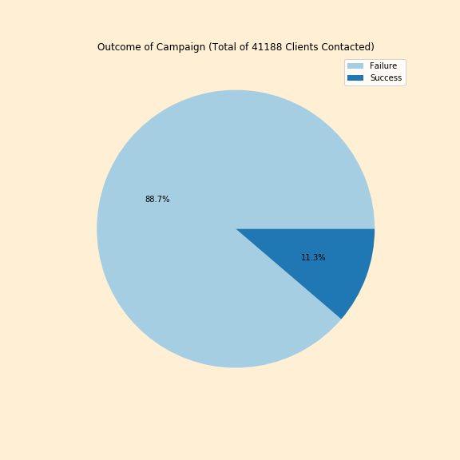
Overall Outcome of Current Campaign
Total number of clients contacted: 41,188
Total successes: 4640
Total failures: 36548
Overall success rate: 11.3%
In a nutshell: Just over 1 in 10 clients contacted subscribed to a long term deposit account

Slide 8
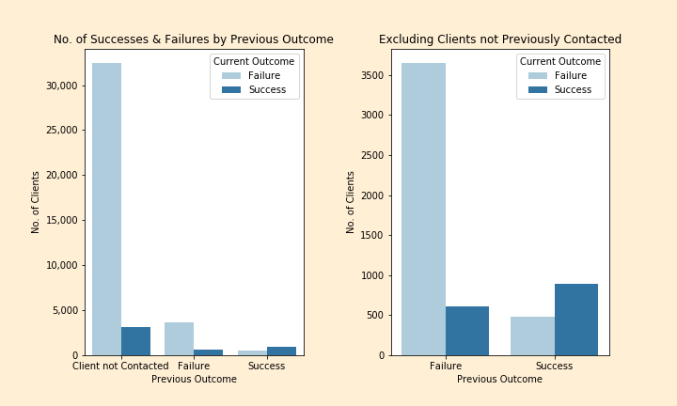
Total Successes and Failures based on Previous Campaign Outcome (Client not Contacted / Failure / Success)
Total number of clients contacted: 41,188
Total successes: 4640
Total failures: 36548
Overall success rate: 11.3%
In a nutshell: Just over 1 in 10 clients contacted subscribed to a long term deposit account

Slide 9
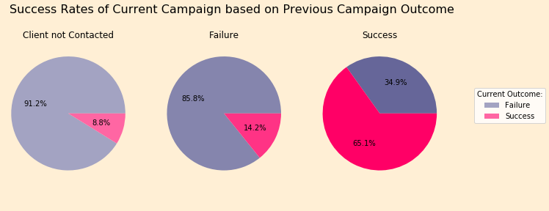
Current Campaign Success Rates based on Previous Campaign Outcomes (Client not Contacted / Failure / Success)
If clients have received a call and previously declined the offer on a previous campaign, they are 5% more likely to subscribe to a long-term deposit account this time around than if they had received no previous contact at all
If a client had previously subscribed to a long-term deposit account, they are significantly more likely to subscribe again than if they had previously declined

Slide 10
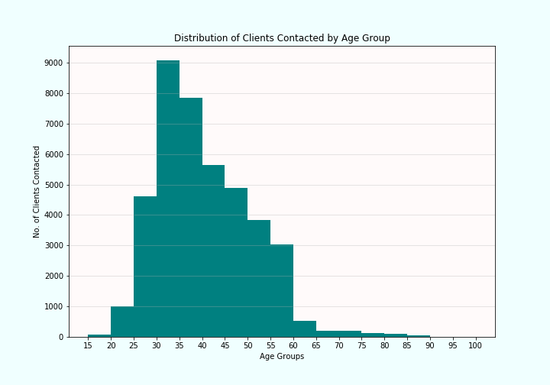
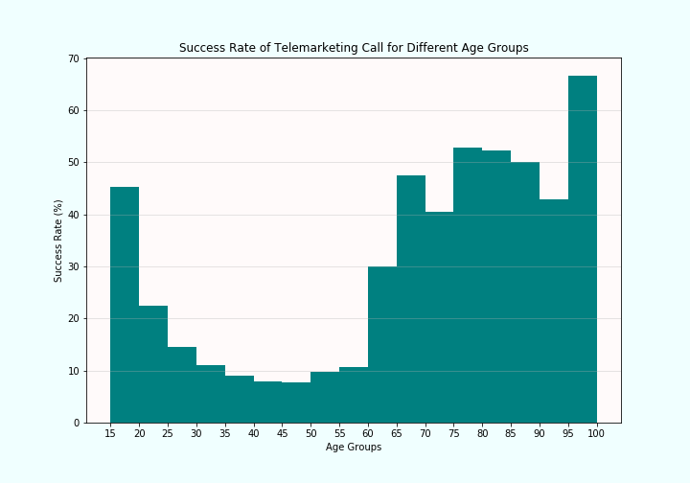
Age Distribution of Clients Contacted & Success Rates for Respective Age Groups
The majority of clients contacted fit within a 25-60 age bracket, however the success rate of calls was strongest for the 60-and-above age groups
Accordingly, if the bank’s primary objective is to increase the number of term deposit accounts opened, it might consider targeting older age groups more

Slide 11
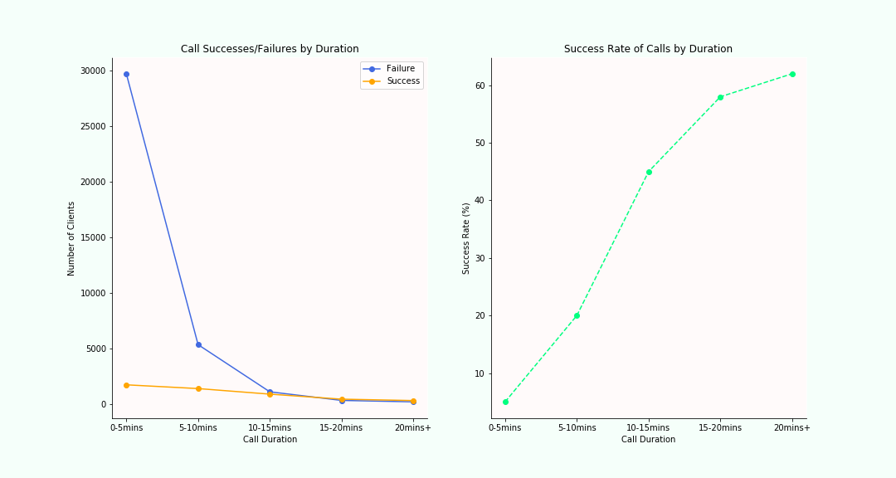
Number of Successes/Failures & Success Rates for Different Call Durations
There is a clear positive correlation between call duration and success rates
However, correlation is not causation (e.g. the high failure rate of 0-5 minute calls is likely to be a reflection of an inherent lack of interest being discovered early on)
Similarly, although some clients may have required more time to be persuaded, some calls may have been longer due to other factors (e.g. general chit-chat, taking longer to go through details or process the opening of an account)
Optimum timing target in future campaigns likely to be 10-20 minutes, since the marginal increase in success tapers off after this point

Slide 12
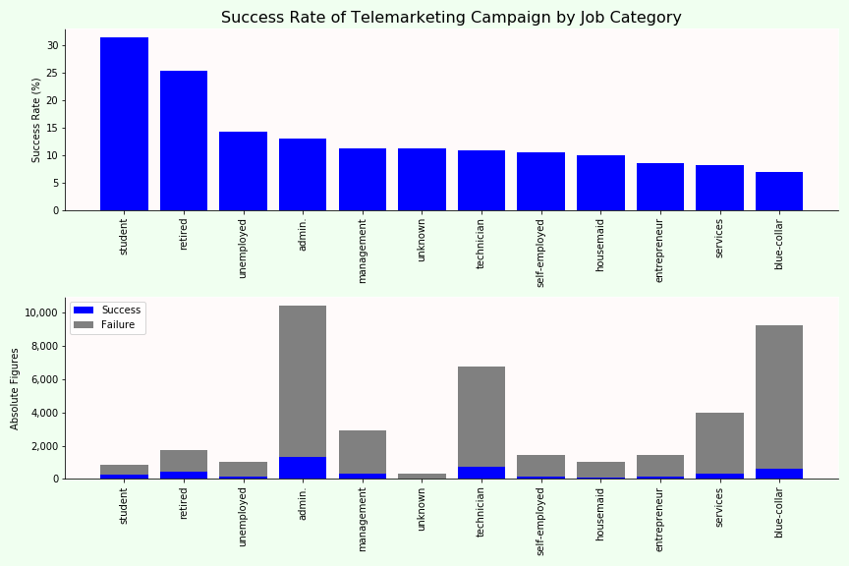
Success Rates by Job Category
Success rates highest for students and retired people (30% and 25% respectively)
Not many clients contacted within these groups
Success rates for other groups are between 7% and 14%
Admin, technician and blue-collar most frequently contacted

Slide 13
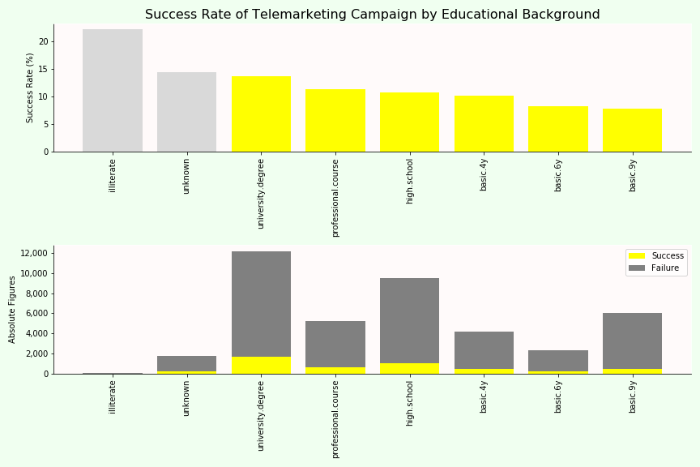
Success Rates by Educational Background
Percentage success rate between different educational backgrounds was relatively marginal
However, those with higher levels of education were slightly more likely to open accounts, possibly because their incomes are likely to have been higher

Slide 14
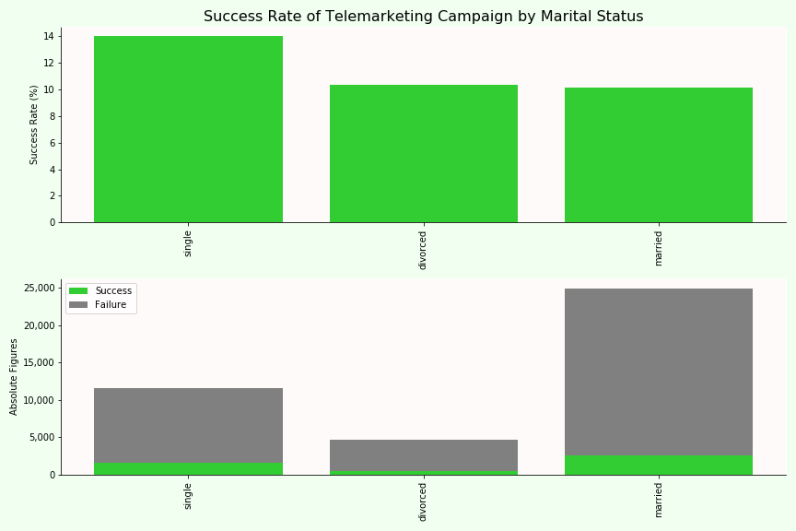
Success Rates by Marital Status
Single clients were 40% more likely to open an account than those who were married or divorced

Slide 15
Conclusions from Slides So Far
Clients who have received previous telemarketing calls are more likely to subscribe, especially if they have subscribed previously, so future campaigns should endeavour to call clients who previously declined again
Calls should be distributed across all age groups if possible, unless there is an exterior reason not to focus so much on the 60+ age groups
Calls should be limited to around 15 minutes, since the likelihood of success does not improve significantly after this point
Students and retired clients are twice as likely to subscribe as working clients of any job category, so future campaigns might target them more
Educational background and marital status do not make a difference significant enough to warrant any change in approach in future campaigns

Slide 16
Telemarketing Outcome Prediction Using K-Nearest Neighbors ML Model
The following slides run through a few stages of my application of a K-Means++ Cluster algorithm to the following four socio-economic features, recorded at the time of each call:
Employment Variation Rate
Consumer Confidence Index
Consumer Price Index
Euribor 3m
The output variable used was the outcome of the calls (0 for failure, 1 for success)
80% of the data was used to train the model and 20% to test

Slide 17
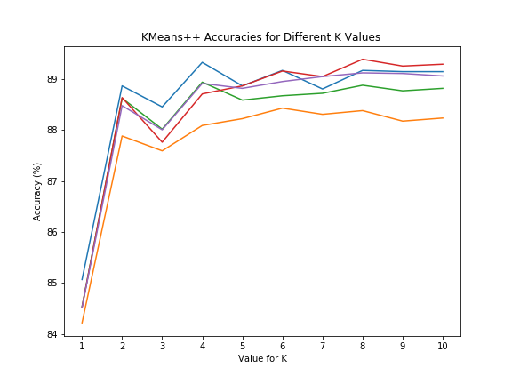
K-Nearest Neighbor on Socio-economic Features – First Attempt
Initially, the algorithm was applied to the entire dataset and produced an accuracy of around 89%, the same as the failure rate of the entire campaign
This indicated that the training data being heavily weighted towards negative outcomes resulted in the algorithm almost always predicting a negative outcome, ‘knowing’ it would be correct 89% of the time, and was therefore not meaningful or accurate
The low k-value (~8) at which the accuracy of the model peaks (as in the diagram) also seems odd given the size of the dataset
(The various plots in the diagram represent different random states used for the splitting of the data into training and validation sets)

Slide 18
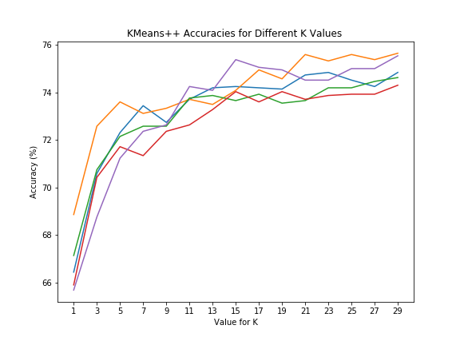
K-Nearest Neighbor on Socio-economic Features – Second Attempt
To address the issue highlighted in the previous slide, I randomly selected 4640 rows with negative outcomes and discarded the remainder, so that there would be an equal number of rows with positive and negative outcomes
This resulted with a model that predicted the outcome with around 75% accuracy, using a k-value of 30
It is therefore clear that the four features together play a significant part in determining the success of term-deposit telemarketing calls

Slide 19
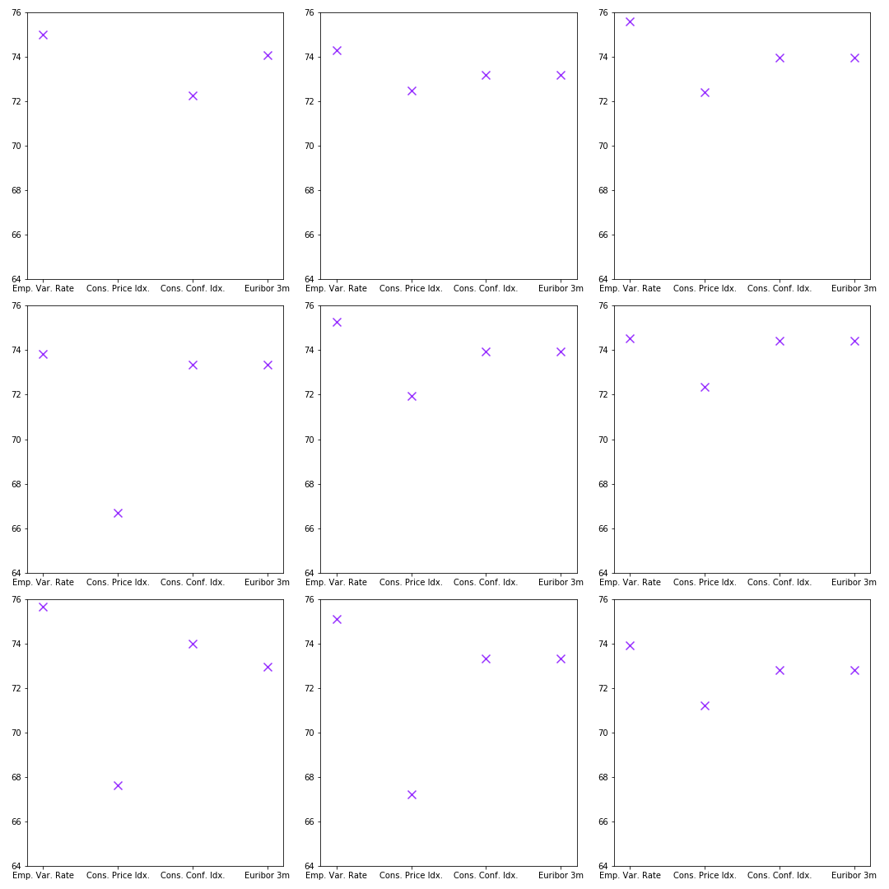
Which factor(s) were the most influential?
Interested to find out which of the four features used for the K-Nearest Neighbors model were most useful for the predictions, I then ran them all individually using 9 different randomly selected rows of data
A pattern can be found to show Employment Variation Rate, Consumer Confidence Index and Euribor 3m to be the most helpful, whereas the accuracy of Consumer Price Index is slightly lower and fluctuates much more
However, since the accuracies of the individual features are very close to each other and the accuracy of the model when they are all used in conjunction, it is likely that they are not entirely independent of each other and reflect similar economic mechanisms

Slide 20
Concluding Remarks
The predictive success of socio-economic factors produced by the original research and to a lesser extent my own model would suggest that telemarketing campaigns selling long-term bank deposits should be scheduled at times when those factors are such that the potential for success is highest
Although the content of this presentation works within my limitations, there are several major questions worth pointing out that reside and cannot be answered without paid access to the research (and possibly not at all):
What was the ultimate goal of predicting the success of these campaigns; was it to ascertain how to calibrate them in the future or simply whether to run them at all?
How were the clients contacted chosen? Why was there such a focus on the 25-60 age group?
How were the callers briefed/trained and did their individual styles have any effect on the outcomes?
Were the calls cost-beneficial, i.e. was an overall success rate of 11% high enough to cover the costs of the campaign and turn a profit from the accounts sold?

